Slide 1
Customer Churn Analysis Telecom Industry
Data Analysis & Machine Learning Project by Makkina Ramya Priya

Slide 2
Project Objective
• Predict which telecom customers are likely to churn.
• Analyze usage and service patterns to find key churn indicators.
• Recommend strategies to retain high-risk customers.

Slide 3
Tools & Technologies Used
• Python (Pandas, Seaborn, Scikit-learn (Random Forest))
• Jupyter Notebook
• Random Forest Classifier
• ELI5
• Data Cleaning & EDA
• Churn Probability Segmentation Model Evaluation (Accuracy, Classification Report)

Slide 4
Dataset Overview
• 3333 customer records
• Features include: call durations, charges, plans, customer service calls
• Target variable: churn (Yes/No)

Slide 5
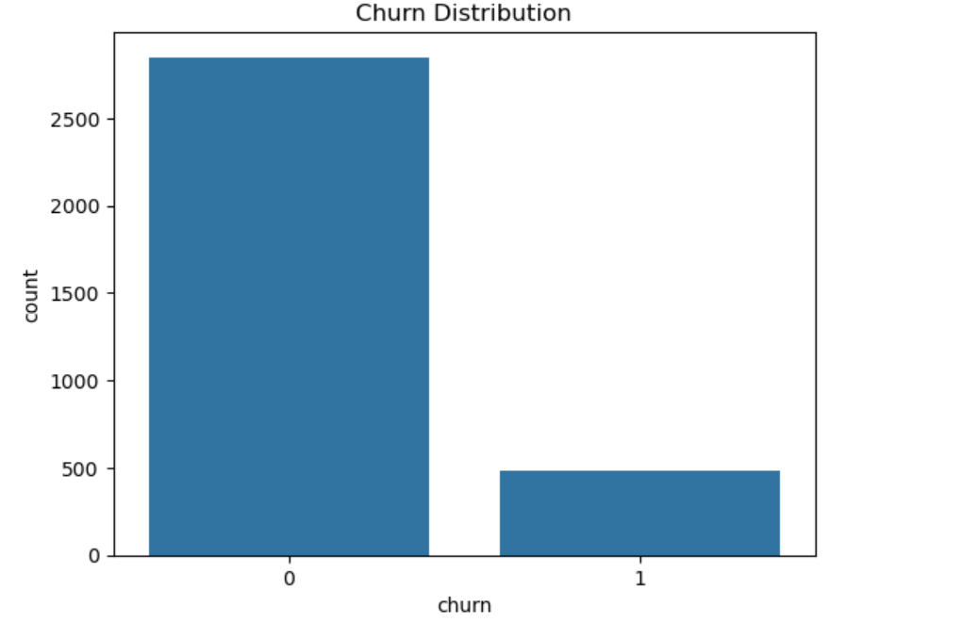
Churn Distribution: Majority Customers Stay, But Losses Matter:
This chart shows the number of customers who churned (1) vs. those who did not (0).
The dataset is imbalanced, with more customers not churning.
Imbalance can bias the model if not handled properly (e.g., using class weighting).

Slide 6
Exploratory Data Analysis (Insights)
• Higher churn among customers with:
- International plan = Yes
- Many customer service calls
- High complaints and low total call time
• Churned users show different call behavior (total_minutes).

Slide 7
Model Summary
• Algorithm: Random Forest Classifier
• Train/Test Split: 80/20
• Accuracy: 97.45%
• Evaluation: Confusion Matrix & Classification Report.

Slide 8
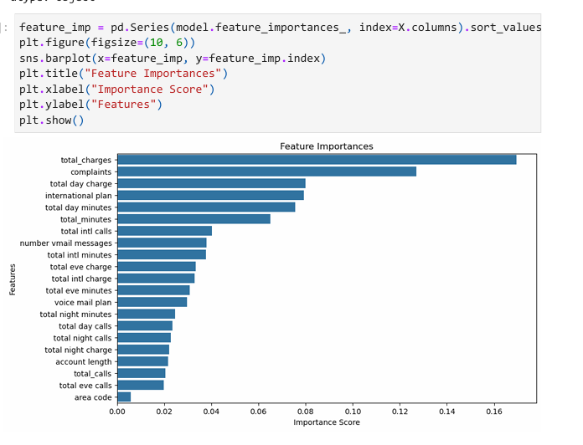
Top Predictors of Customer Churn
The chart highlights which customer features most influenced churn prediction based on the Random Forest model:
🔹 total_charges, complaints, and international_plan were the most important drivers of churn. 🔹 These insights guide actionable strategies, such as improving complaint handling and reviewing pricing plans.
The feature importance was calculated using model-based scoring, helping prioritize business areas that directly impact churn.

Slide 9
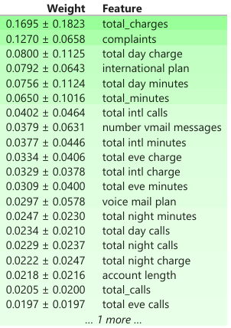
Model Explainability with ELI5
ELI5 was used to explain how the Random Forest model makes predictions.
It highlighted total charges, complaints, and international plan as key drivers of churn.
This helps non-technical teams understand and trust model outcomes.

Slide 10
Business Recommendations
Use churn segments for targeted offers (At Risk customers)
• Focus on customers with frequent service calls
• Offer loyalty benefits to high-usage long-tenure customers
• Reduce churn by improving support for international plan users
• Use churn segments for targeted offers (At Risk customers)

Slide 11
Churn Segmentation Overview
• Churn probabilities calculated using model.predict_proba()
• Segments:
- At Risk → churn_prob > 0.7
- Loyal → 0.3 ≤ churn_prob ≤ 0.7
- Dormant → churn_prob < 0.3
• Enables targeted marketing and retention strategies

Slide 12
Final Recommendations
Target "At Risk" customers with personalized retention plans
Improve service for high-complaint users to reduce churn
Offer flexible recharge plans for low-engagement users
Re-engage dormant users with free data or discounts
Reward loyal users to improve brand advocacy

Slide 13

Thank You

